Slide 1
Module 4: Describing Chemical and Physical Changes
Submicroscopic Models of Chemical Change
Fundamentals of Chemistry Open Course

Slide 2
Learning Objectives | Module 4
Distinguish between chemical and physical changes, particularly in equations containing chemical formulas.
Interpret chemical equations to visualize chemical reactions or physical changes.
Determine whether a given chemical equation is balanced or not; balance chemical equations.
Apply chemical equations to determine the outcome of a chemical reaction on the submicroscopic level.
Convert a submicroscopic image of a chemical reaction or physical change into a chemical equation.

Slide 3

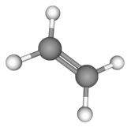
Submicroscopic Models of Chemical Reactions
When molecules combine in chemical reactions, atoms are conserved. Each reaction event takes place
in accordance with the balanced chemical equation.
Using a balanced equation and numbers of reactant molecules, we can work out
the composition of a reaction mixture at the end of the reaction.
Example. Ethylene (C₂H₄) reacts with oxygen (O₂) according to the balanced chemical equation below. What is the composition of the reaction mixture at the end of the reaction, given the numbers of molecules in the image?
C₂H₄(g) + 3 O₂(g) → 2 CO₂(g) + 2 H₂O(g)

Slide 4
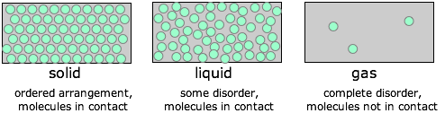
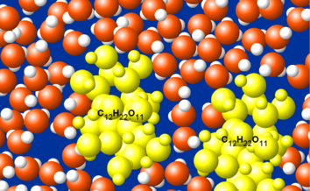
State of Matter in Chemical Equations | 1 of 2
Phase designators help us visualize each component of a chemical reaction
on the macroscopic and submicroscopic levels.
Recall our submicroscopic models for the solid, liquid, gaseous, and aqueous states.
We can use these to visualize changes in the spatial distributions of particles during chemical reactions.
aqueous
solute molecule surrounded by water molecules

Slide 5
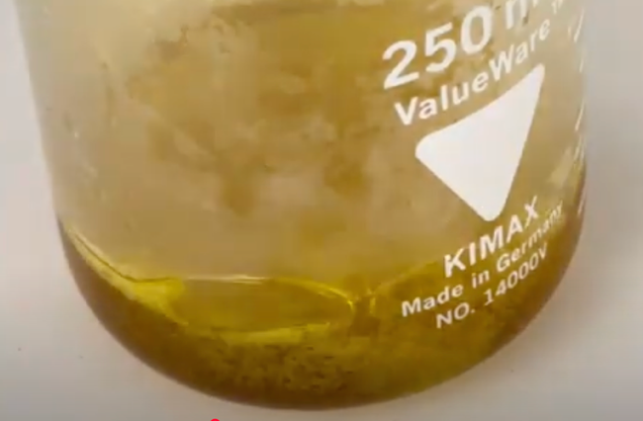
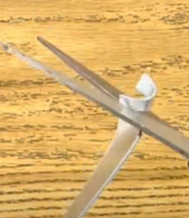
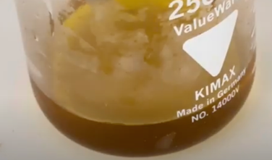
State of Matter in Chemical Equations | 2 of 2
Phase designators help us visualize each component of a chemical reaction
on the macroscopic and submicroscopic levels.
Phase designators also help us visualize macroscopic chemical change!
Example. The reaction of zinc metal with aqua regia proceeds according to the balanced equation below.
2 Zn(s) + 2 HCl(aq) + 2 HNO₃(aq) → ZnCI₂(aq) + Zn(NO₃)₂(aq) + 2 H₂(g)

Slide 6
Lingering Questions
Why do chemical reactions happen? What are the driving forces that govern when and how
chemical reactions take place?
Most chemical reactions occur over two or more collisions between atoms or molecules. How do we think about and study reactions that require multiple steps?

